Slide 1

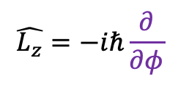



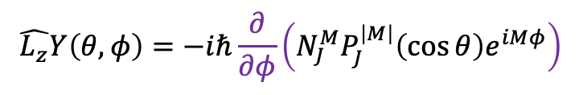



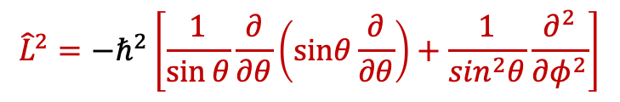


Upper limit of magnetic quantum number
$$\hat{L_{z}}=−iℏ\frac{∂}{∂φ}$$
$${\hat{L}}^{2}={−ℏ}^{2}\left[\frac{1}{\sin{θ}}\frac{∂}{∂θ}\left(\text{sin}\text{θ}\frac{∂}{∂\text{θ}}\right)+\frac{1}{\sin^{2}θ}\frac{∂^{2}}{∂φ^{2}}\right]$$
$$Y\left(θ,φ\right)=N_{J}^{M}P_{J}^{\left|M\right|}\left(\cos{θ}\right)e^{iMφ}$$
$$\hat{L_{z}}Y\left(θ,φ\right)=−iℏ\frac{∂}{∂φ}\left(N_{J}^{M}P_{J}^{\left|M\right|}\left(\cos{θ}\right)e^{iMφ}\right)$$
$$=−\left\{iℏN_{J}^{M}P_{J}^{\left|M\right|}\left(\cos{θ}\right)\right\}.iM.\left(e^{iMφ}\right)$$
$$=ℏM.Y\left(θ,φ\right)$$
$${\hat{L_{z}}}^{2}Y\left(θ,φ\right)=ℏ^{2}M^{2}.Y\left(θ,φ\right)$$
$${\hat{L}}^{2}Y\left(θ,φ\right)=ℏ^{2}J\left(J+1\right)Y\left(θ,φ\right)$$
$${\hat{L}}^{2}Y\left(θ,φ\right)−{\hat{L_{z}}}^{2}Y\left(θ,φ\right)=ℏ^{2}J\left(J+1\right)Y\left(θ,φ\right)−ℏ^{2}M^{2}.Y\left(θ,φ\right)$$
$$\left({\hat{L}}^{2}−{\hat{L_{z}}}^{2}\right)Y\left(θ,φ\right)−=ℏ^{2}\left\{J\left(J+1\right)−M^{2}\right\}Y\left(θ,φ\right)$$
$$J\left(J+1\right)≥M^{2}$$
$$\left|M\right|≤J$$
$$\left({\hat{L_{x}}}^{2}+ {\hat{L_{y}}}^{2}\right)Y\left(θ,φ\right)−=ℏ^{2}\left\{J\left(J+1\right)−M^{2}\right\}Y\left(θ,φ\right)$$
$$≥0$$

